Slide 1
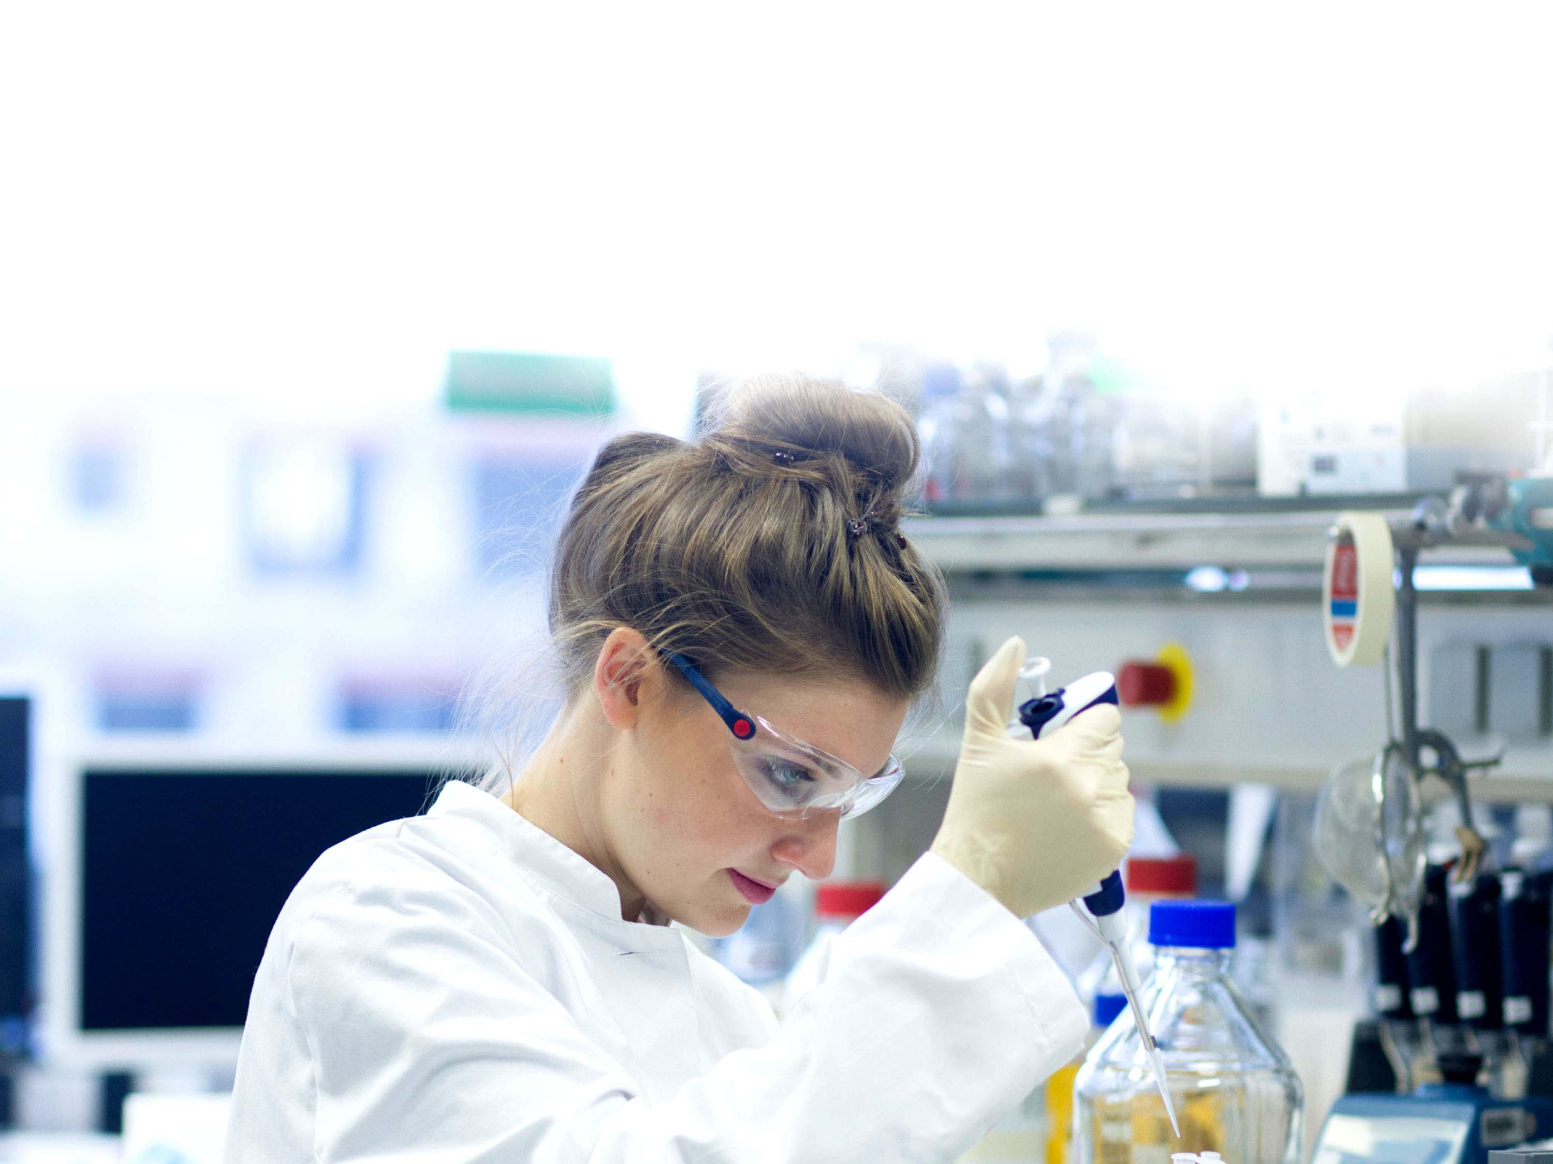

Slide 2

What is CALDO?
CALDO is your gateway to connect with top Canadian universities, offering high ranked programs in both English and French to students from all over Latin America

Slide 3


CALDO Universities

Slide 4

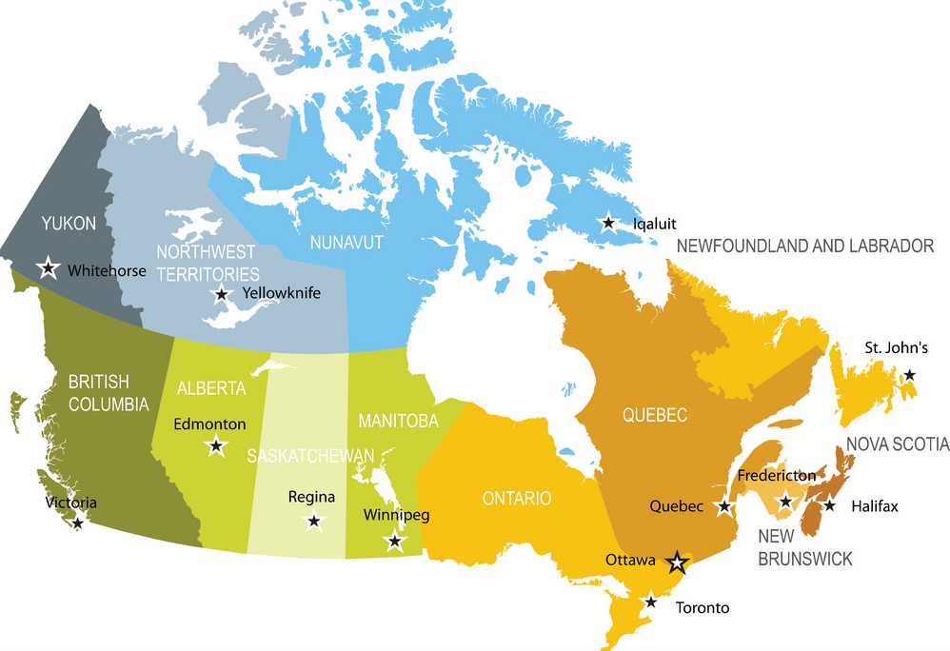

Slide 5

The Canadian Academic System
Master’s Degree
Professional and Course based MA - NOT PhD Suitable
Research Thesis (typically 2 years)
Doctoral Programs (PhD) (4 to 5 years)

Slide 6
CALDO Free Services
Assistance with the steps to apply for graduate programs at any of our member universities
Guidance on how to contact with professors/thesis supervisors at any of our member universities

Slide 7
How does CALDO benefit students?
Single point of contact for having access to our universities;
Guidance on researching master’s and PhD programs at each of our CALDO universities;
Guidance on how to contact with potential supervisors;
Personalized counselling for any day-to-day problems

Slide 8
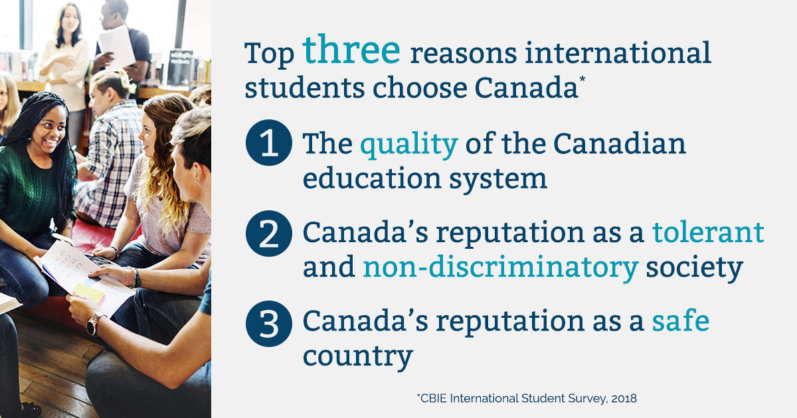
Why do international students choose Canada? (CBIE)

Slide 9
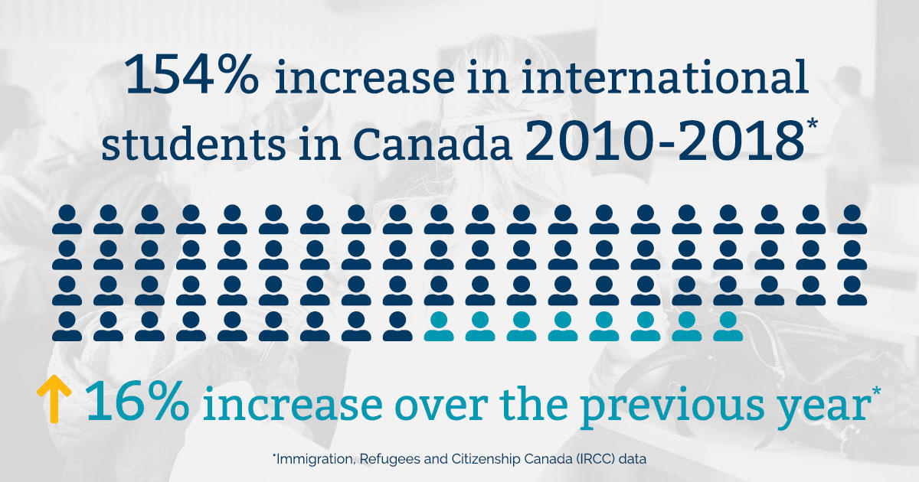
In 2018 the number of international students in Canada increased16% over 2017 (CBIE)

Slide 10

CALDO website

Slide 11
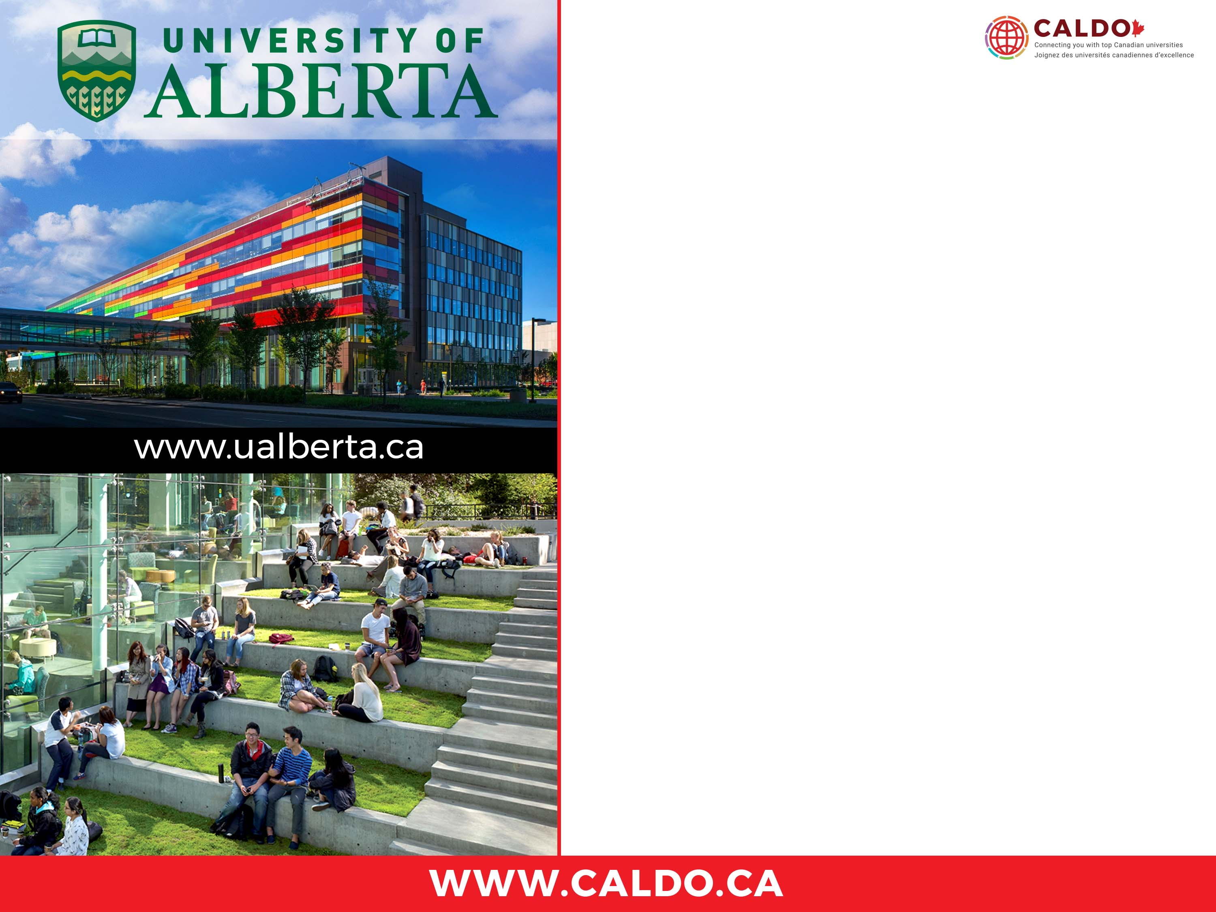
Edmonton, Canada
Ranked in the world’s TOP 100 Universities.
Among the top 5 Canadian Universities in annual total research funding.
Ranked #40 "most international" university in the world by Times Higher Education.
18 faculties offering 500+ Master’s and PhD programs.
UAlberta is ranked #6 in the world for Energy and Environment Research Publications.
6 programs in global top 10
8 subject areas ranked in global top 50
Research Excellence
Energy and Environment
Health
Science and Technology
Public Policy and Society
Arts and Humanities

Slide 12
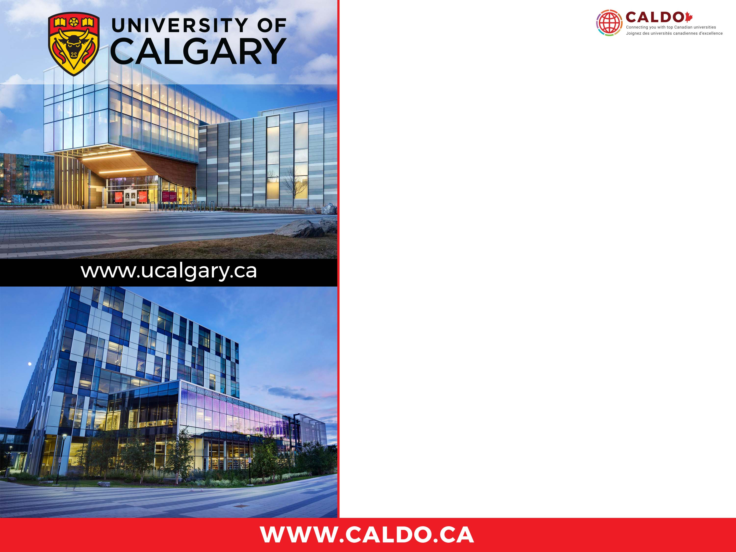
Calgary, Canada
North America’s #1 young university (QS 2016)
#6 top research university in Canada
Top 200 universities worldwide (THE)
#1 most liveable city in North America and #4 in the world (2018 Global Liveability Ranking, Economics Intelligence Unit)
14 faculties offering over 100 Master’s and PhD programs.
Professional development and paid internships.
Research Excellence
Energy Innovations for today and tomorrow
Human dynamics in a changing world
Engineering solutions for health
New Earth-space technologies
Infections, inflammation and chronic diseases
Brain and Mental Health

Slide 13
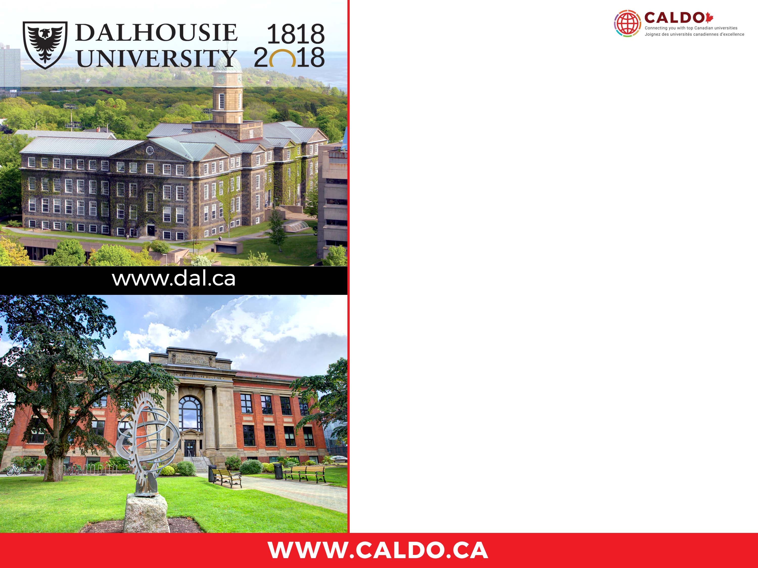
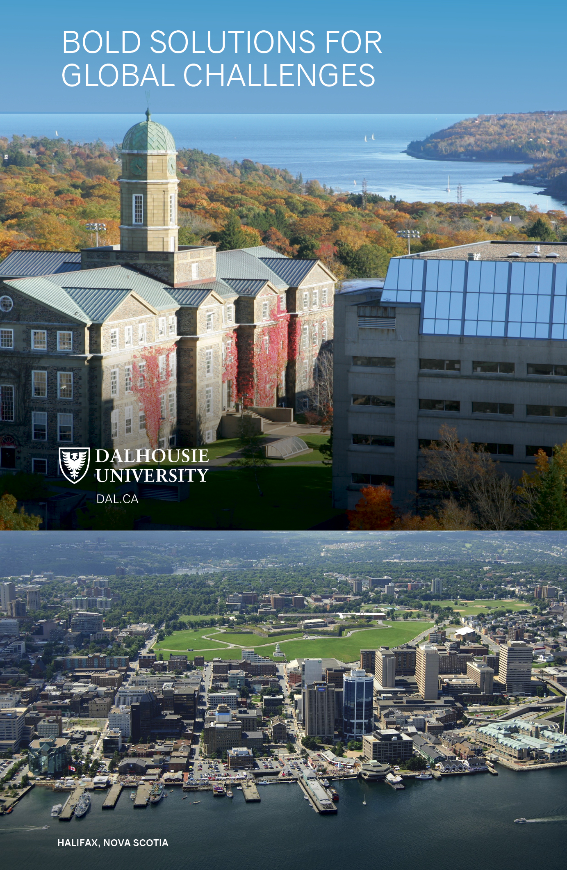
Halifax, Nova Scotia, Canada
Top 5 international university in Canada
(THE rankings)
QS Five Stars Rated for Excellence
Home to MIT Regional Entrepreneurship Acceleration Program
Home to the Ocean Frontier Institute involving 8 international institutions from 5 countries (France, Germany, Ireland, Norway, USA)
Halifax: A city with a distinctive coastal culture
Signature Research Clusters
(Cross-cutting themes: Big Data;
Innovation & Entrepreneurship)
Sustainable Ocean
Clean Technology, Energy, the Environment
Healthy People, Healthy Communities,
Healthy Populations
Food Security
Culture, Society, Community Development

Slide 14
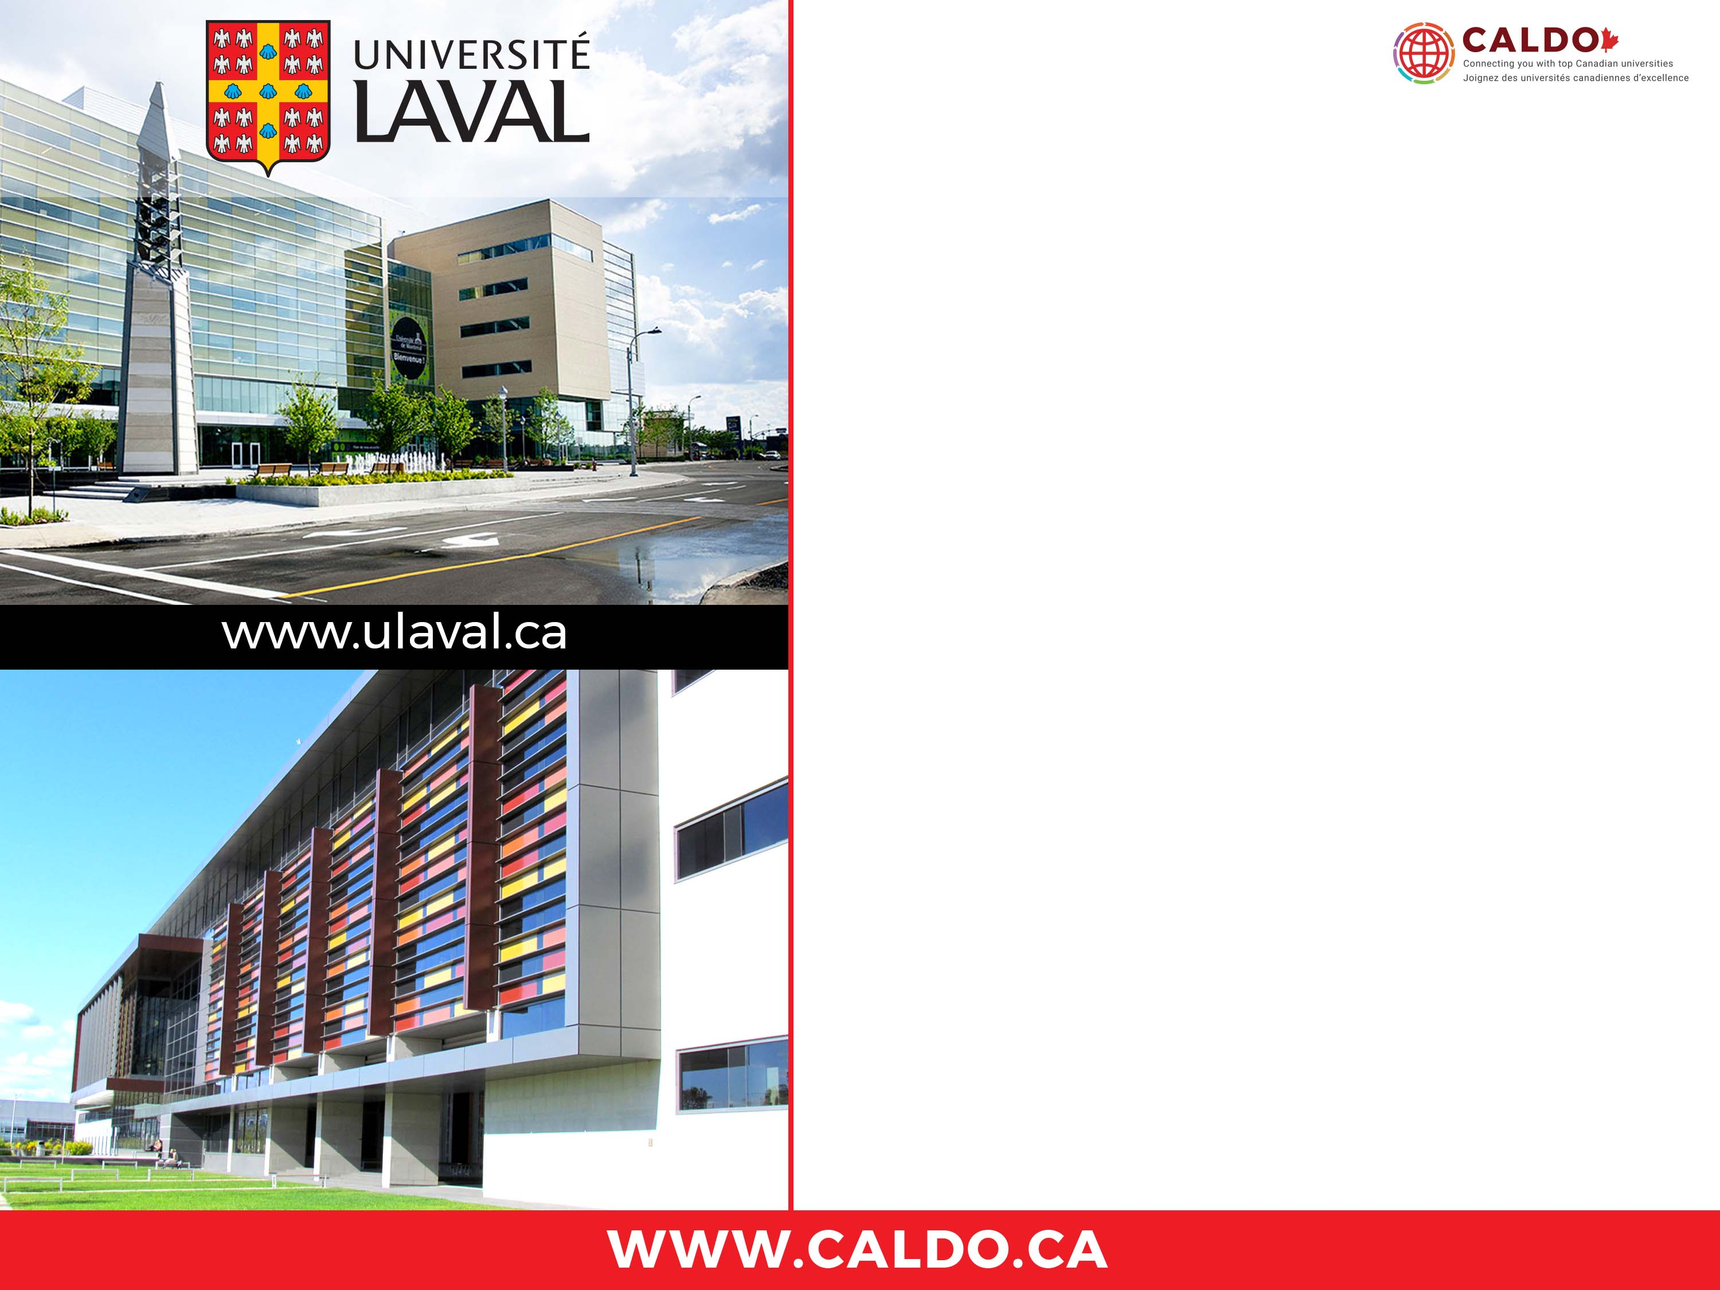
Québec City, Canada
First French-language university in North America
45,000 students/500 programs
Green campus with 40 buildings, 17 faculties and the biggest university sports centre in the Eastern Canada
5,800 international students from 120 countries
Within the top 6 research universities in Canada with more than 270 centres and research groups
3,650 professors and researchers of international reputation
Ranked #1 in Canada and #2 in the world in sustainable development
Research Excellence
Nordic and Artic research
Health
Optics/photonics
Artificial Intelligence
Sustainable development

Slide 15

Ottawa, Canada
North America’s Largest Bilingual University.
176th overall in the T.H.E. World University ranking
9 faculties offering 164 Master’s and PhD programs.
8 subjects among the top 150 QS world rankings.
Research Excellence
e-Society
Health
Molecular and Environmental Sciences
Canada and the World

Slide 16

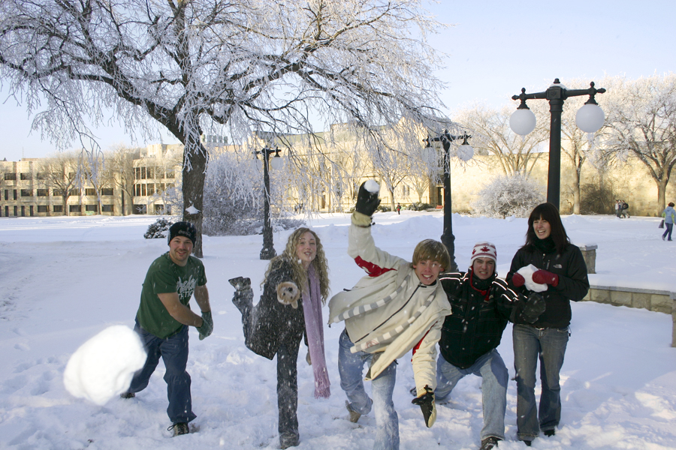
Saskatoon, Canada
16 faculties offering 154 Master’s and PhD programs
QS World Ranked top 100: Agriculture, Water Resources, Environmental Science and Engineering, Veterinary Science.
The Crop Development Centre: more than 400 commercial crop varieties.
VIDO-InterVac: global leader in human and animal infectious disease and vaccine development.
The Canadian Light Source: one of the world’s leading synchrotron facilities.
Research Excellence
Water Security and Freshwater Resources
Food and Bioproducts for a Sustainable Future
Veterinary and Animal Sciences
Energy and Mineral Resources
Synchrotron Sciences: Innovation in Health, Environment and Advanced Technologies
Notes:
Ranked #18 on the New York Times 52 Places to Go in 2018 list. Yes, the winters are long and cold, but this riverside city is filled with warm hearted people and culture.

Slide 17
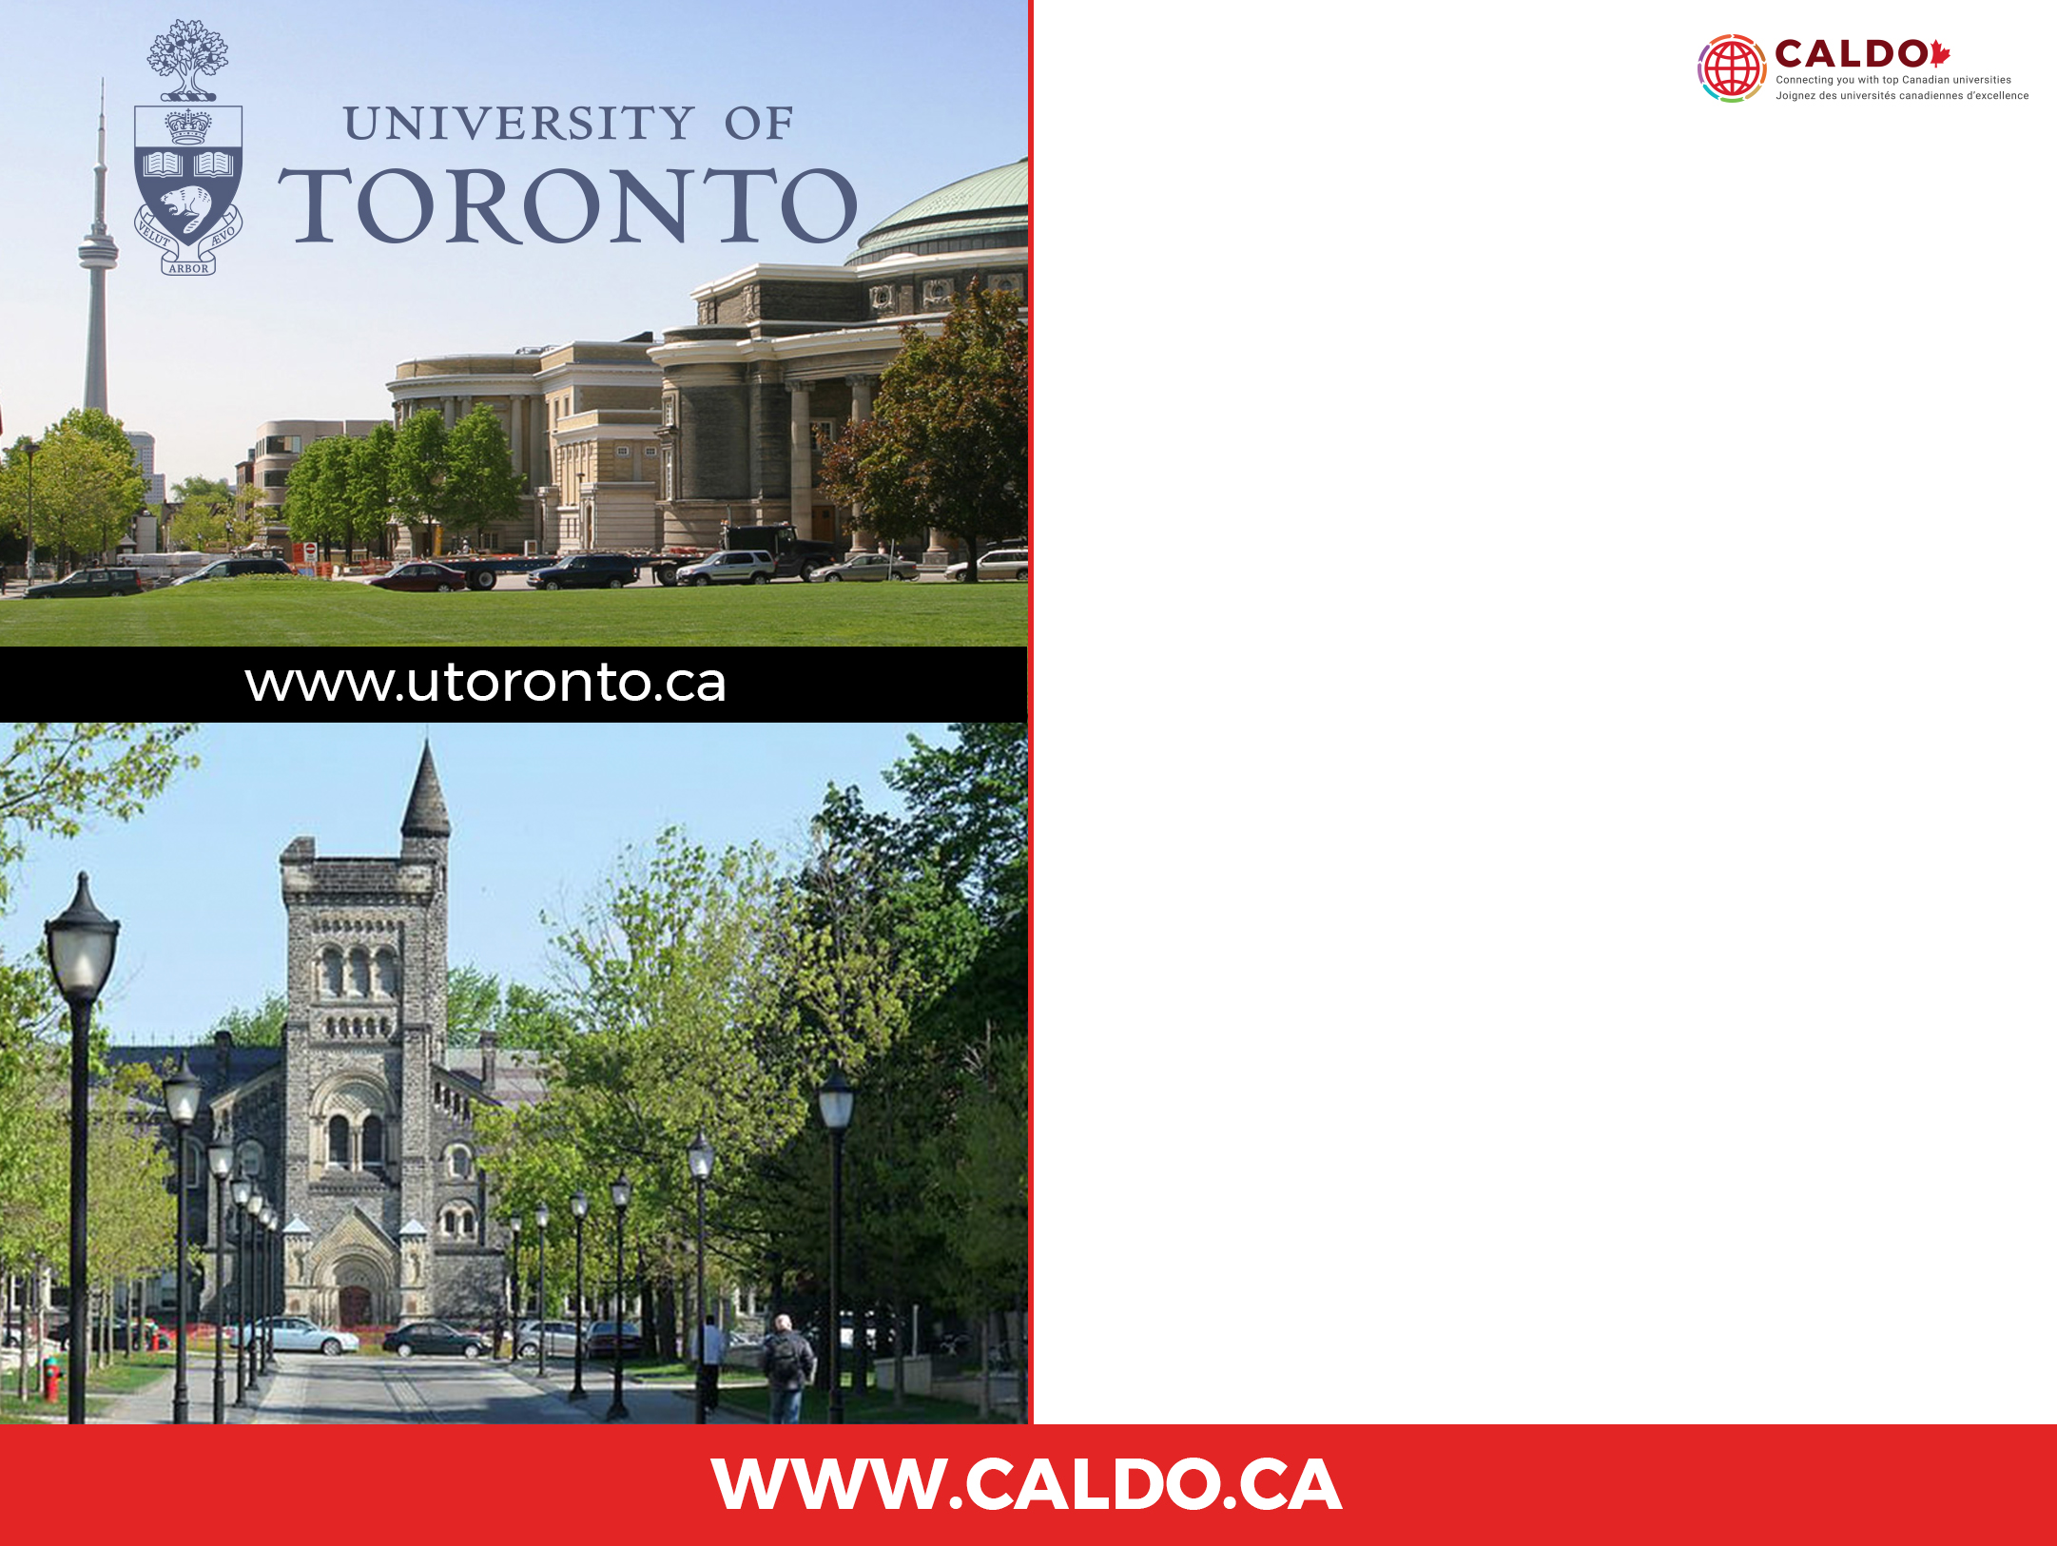
Toronto, Canada
Canada’s largest university.
#1 university in Canada, and 22nd in the world according to Times Higher Education (2017-18).
18 faculties and schools offering more than 280 Master’s and PhD programs.
$1.2 billion annually in external research funding
9 partner teaching hospitals.
Third-largest library system in North America.
Research Excellence
Medical science, especially regenerative medicine
Philosophy, Medieval and Renaissance Studies
Computer science and engineering, especially machine learning
Urban studies

Slide 18
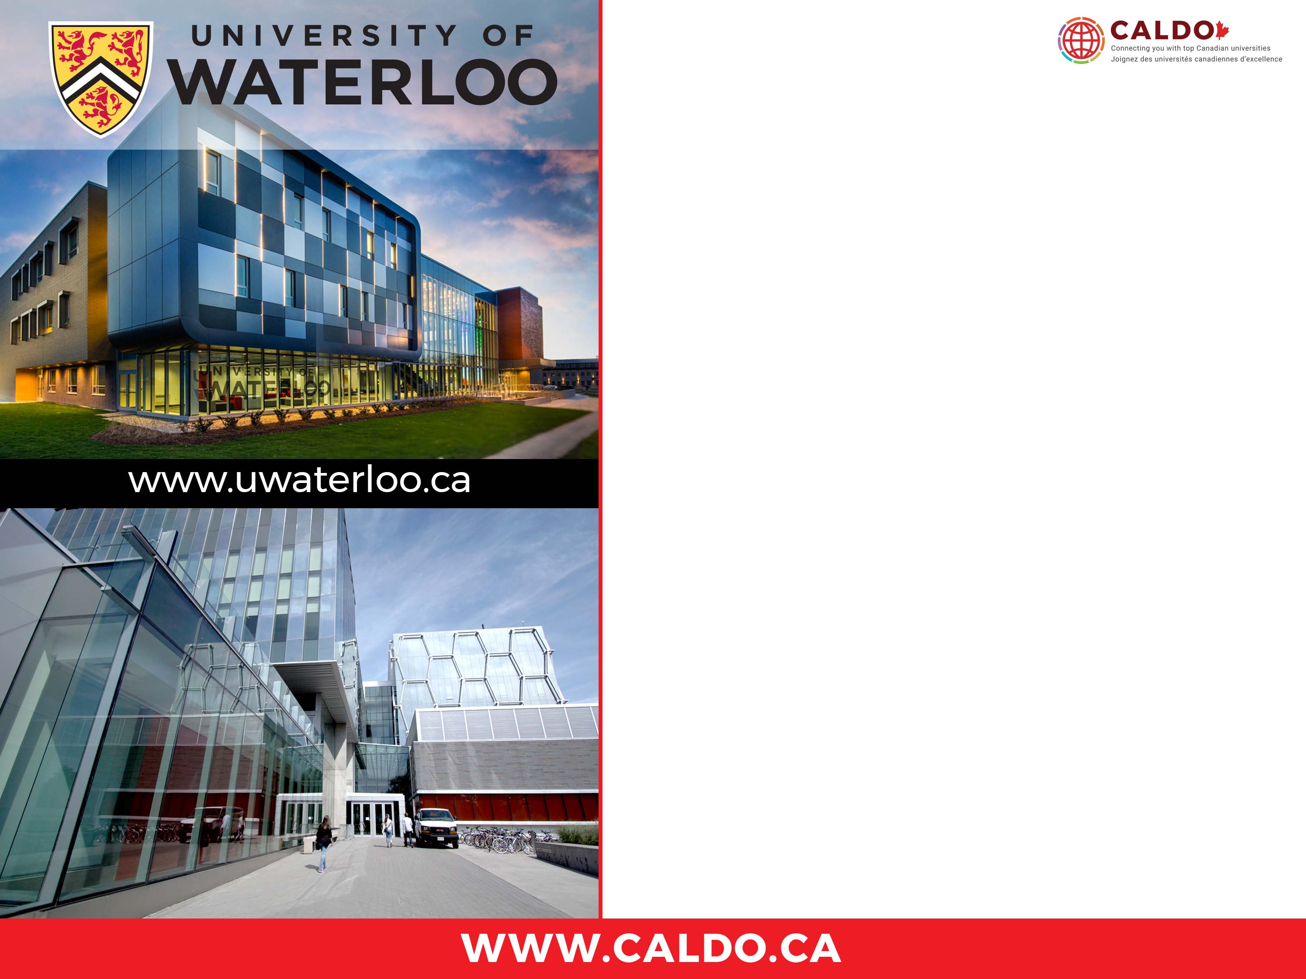
Waterloo, Canada
Globally Recognized Excellence
#1 comprehensive research university in Canada (Research Infosource)
#2 in Canada for computer science and #1 in Canada for engineering (U.S. News and World Report Best Global Universities 2018)
Research University of the Year among Canadian comprehensive universities for ten consecutive years (Research Infosource)
Most innovative university in Canada for 26 consecutive years (Maclean's)
TOP 40 in the world for computer science and math (QS)
TOP 60 in the world for engineering and technology (QS)
Research Excellence
6 faculties, 4 affiliated institutions & 3 satellite campuses offering 180+ graduate programs including:
  Biotechnology
  Information Technology
  Environment and energy
  Materials manufacturing and devices

Slide 19
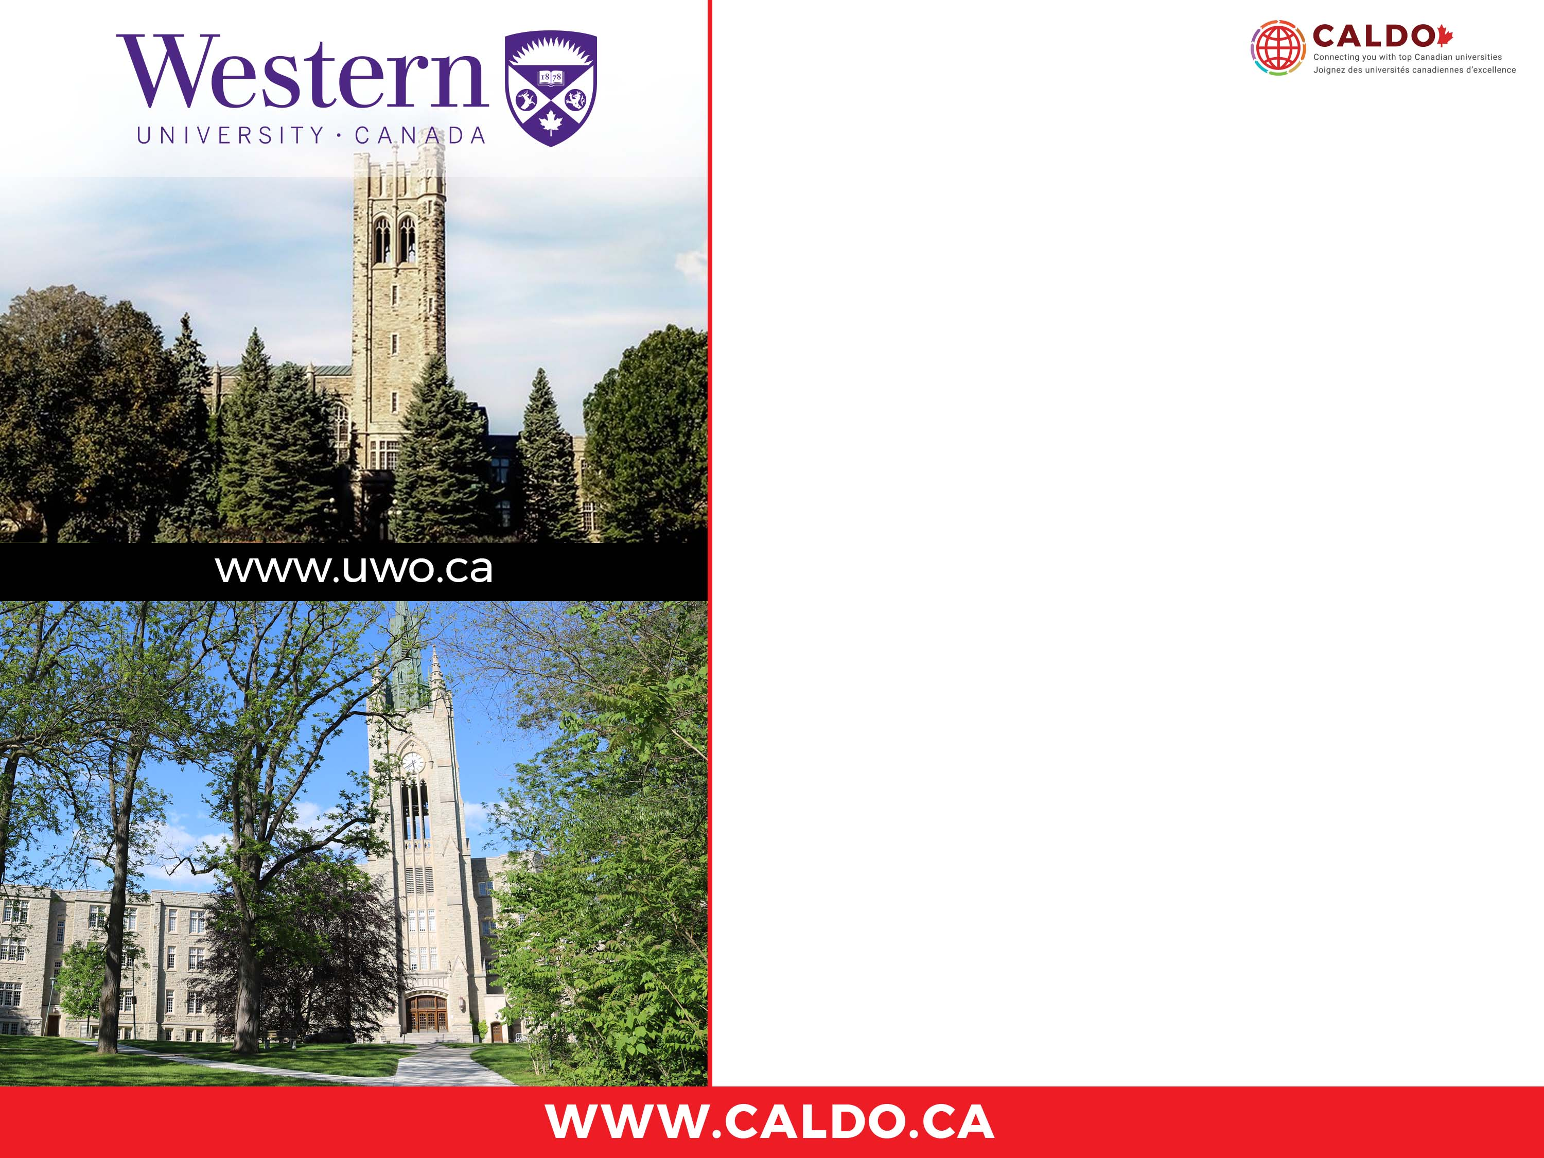
London, Canada
Ranked among the top 1% of institutions of higher education worldwide
Rated with 5 stars from QS Stars, recognizing world-class quality of education
Over 240 million in annual research expenditures
11 Faculties offering 160 Master’s and PhD programs
Research Excellence
Neuroscience/Brain and Mind/ Imaging
International and Intercultural Relations
Wind Engineering and Natural Disaster Mitigation
Environmental Sustainability and Green Energy
Materials and Biomaterials

Slide 20


Slide 21
CONTACT US
graduate.coordinator@caldo.ca

